Slide 2
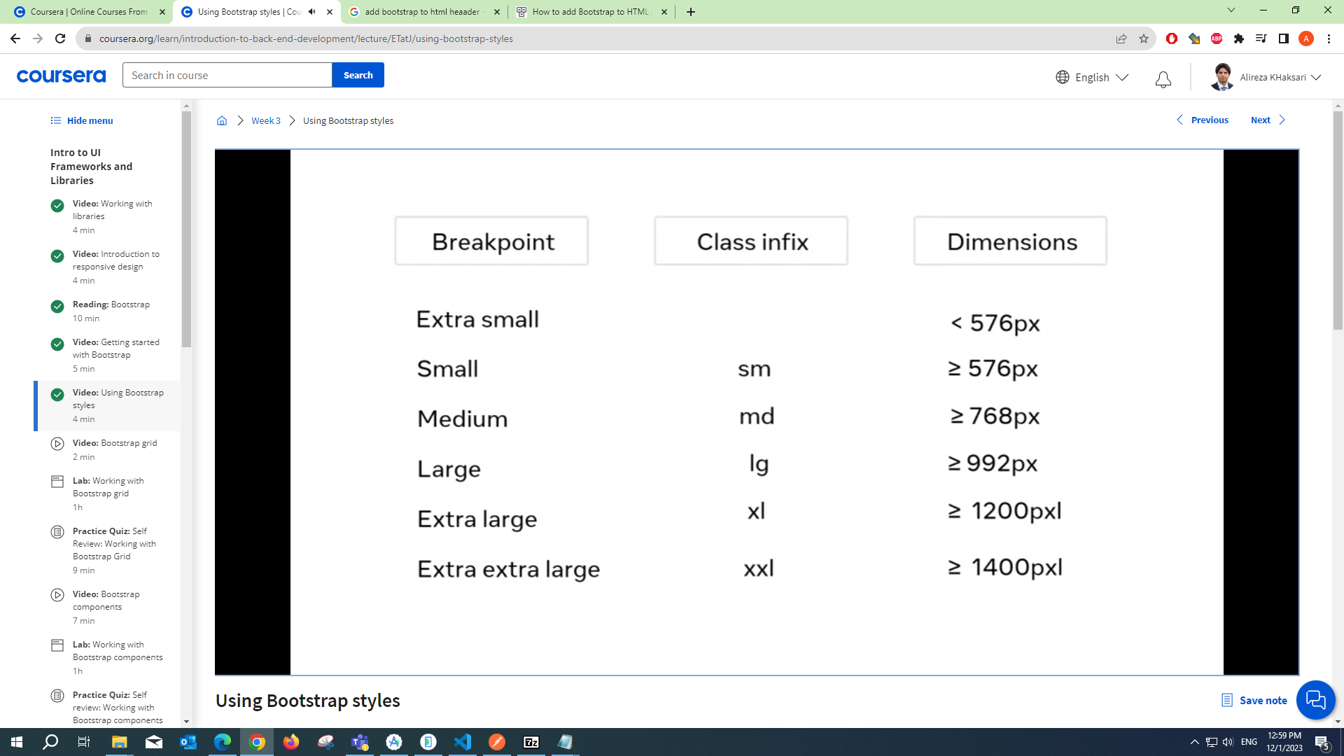
C01_W03: Bootstrap Introduction

Slide 3
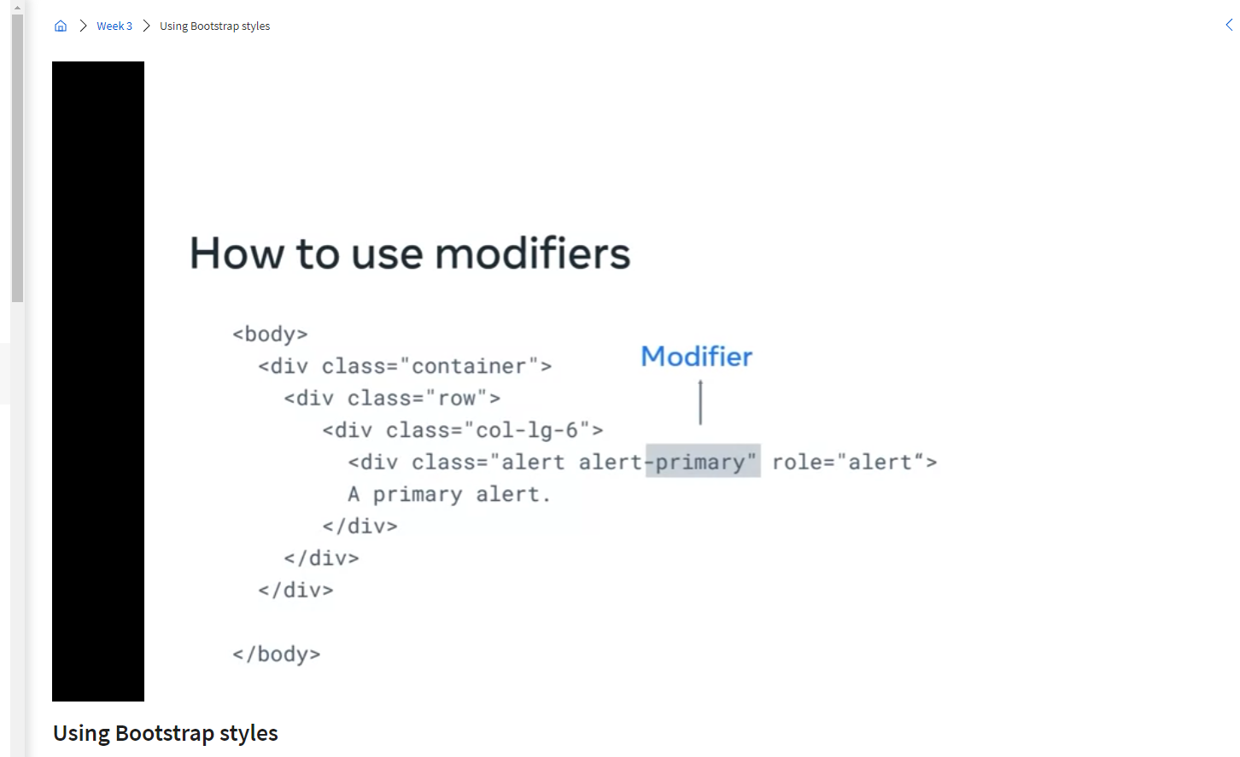
C01_W03: Bootstrap Introduction

Slide 4
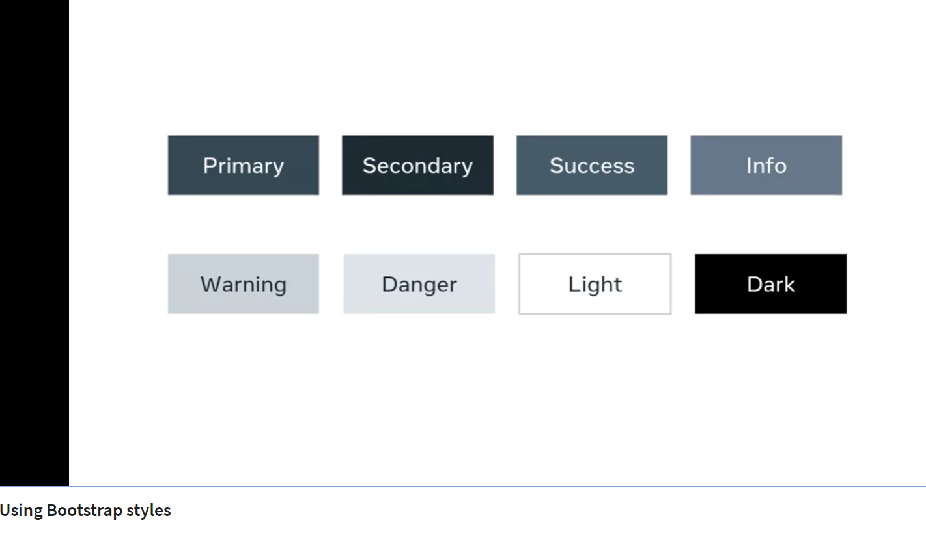
C01_W03: Bootstrap Introduction
Bootstrap Modifiers
Primary alerts display in blue
Danger alerts display in red

Slide 5
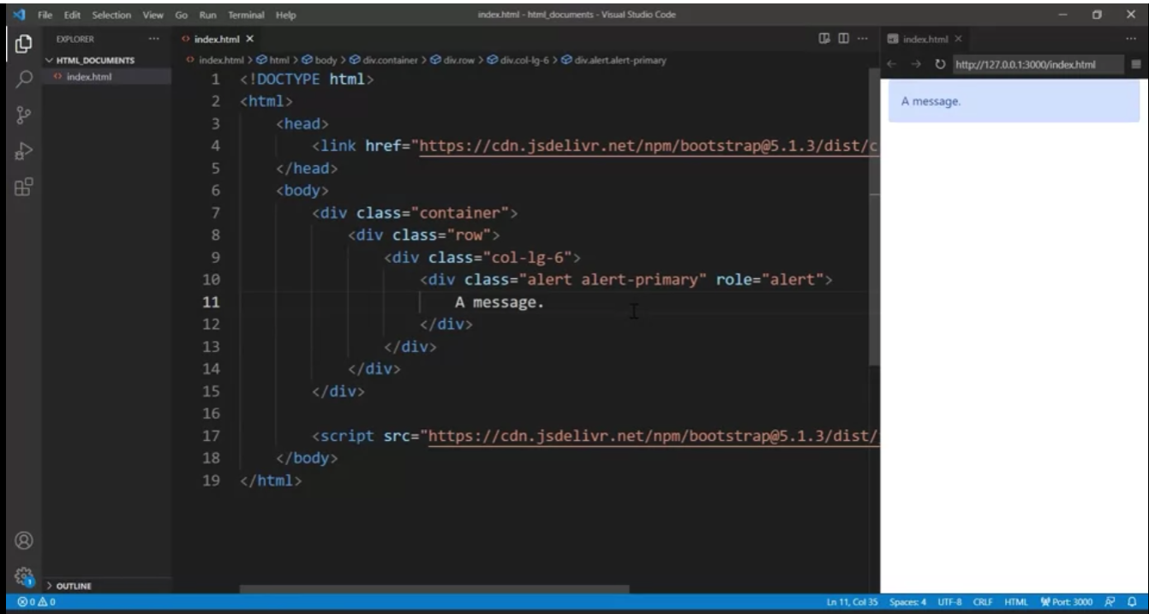
C01_W03: Bootstrap Introduction

Slide 6
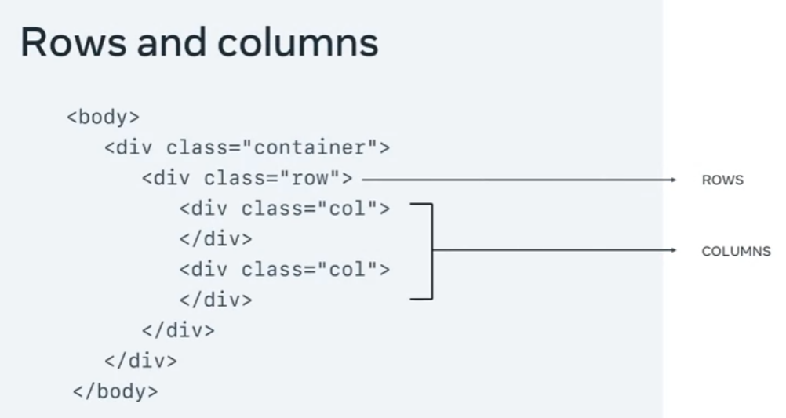
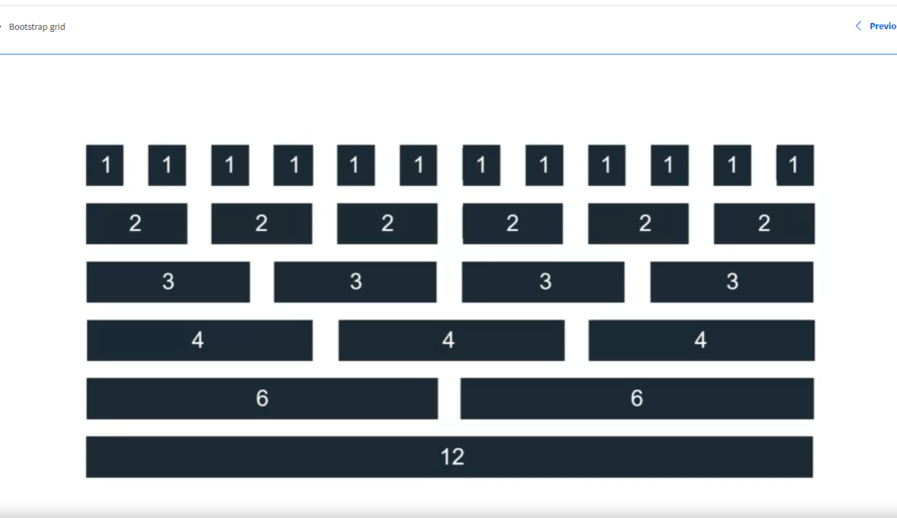
C01_W03: Bootstrap Introduction
Bootstrap Grid system.

Slide 7
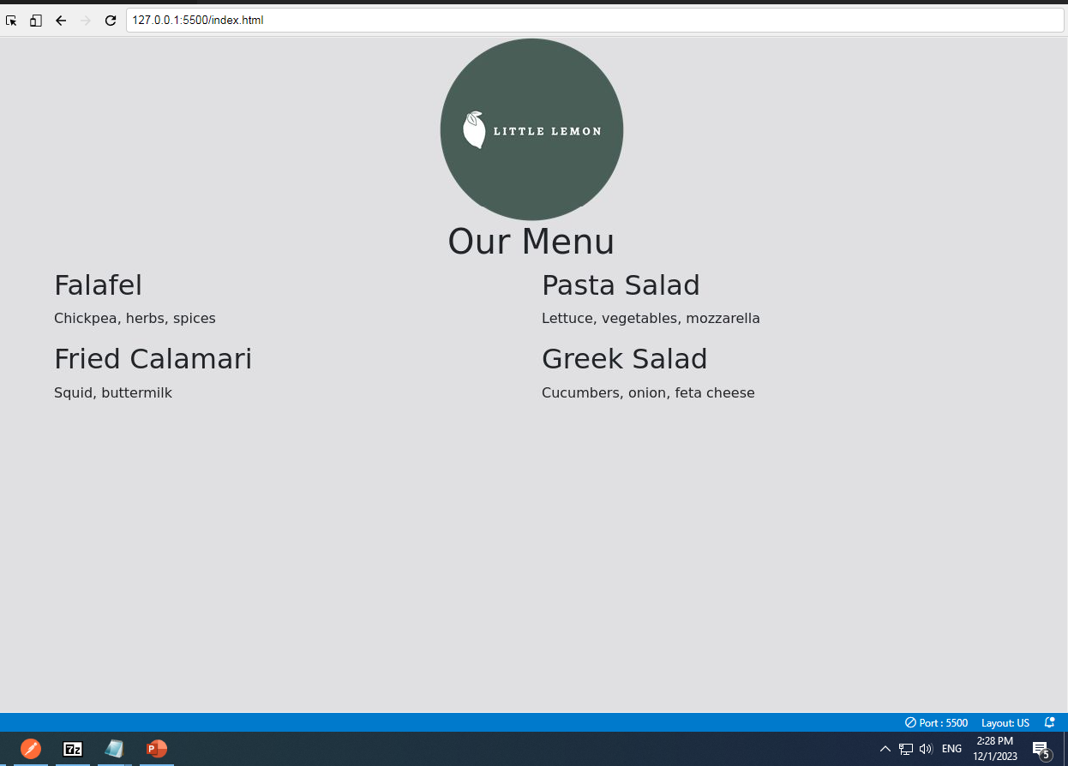
C01_W03: Bootstrap Introduction
Bootstrap Grid system.
<!DOCTYPE html>
<html>
<head>
<title>Little Lemon</title>
<link href="bootstrap.min.css" rel="stylesheet">
</head>
<body>
<script src="bootstrap.bundle.min.js"></script>
<div class="container">
<div class="row">
<div class="col-12">
<div class="text-center">
<img src="logo.png" class="img-fluid">
</div> </div>
</div>
<div class="row">
<div class="col-12">
<div class="text-center">
<h1>Our Menu</h1>
</div>
</div>
</div> <div class="row">
<div class="col-12 col-lg-6">
<h2>Falafel</h2>
<p>Chickpea, herbs, spices</p>
<h2>Fried Calamari</h2>
<p>Squid, buttermilk</p>
</div>
<div class="col-12 col-lg-6">
<h2>Pasta Salad</h2>
<p>Lettuce, vegetables, mozzarella</p>
<h2>Greek Salad</h2>
<p>Cucumbers, onion, feta cheese</p>
</div>
</div>
</div>
</body>
</html>

